Slide 1
strings
Lab#7

Slide 2

STRING
The string is any sequence of characters
Every string is terminated by a ‘\0’ character.
To use strings, you need to include the header <string>
The string is one of the C++ built-in classes.
C++ strings allow you to directly initialize, assign, compare, and reassign with the intuitive operators, as well as printing and reading (e.g., from the user).

Slide 6
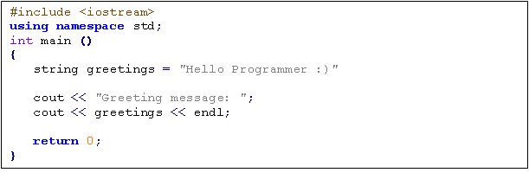
EXAMPLE:
# Output
Greeting message Hello Programmer :)

Slide 7
EXAMPLE
string name; cout << "Enter your name: " << endl; cin >> name; cout << “Welcome " << name <<“\n Have a nice day \n”;
Enter your name:
Sidra
Welcome sidra
Have a nice day

Slide 8
Strings concatenation with the + operator
C++ strings also provide many string manipulation facilities. The simplest string manipulation that we commonly use is concatenation, or addition of strings. In C++, we can use the + operator to concatenate (or “add”) two strings, as shown below:
string result; string s1 = "hello "; string s2 = "world"; result = s1 + s2; // result now contains "hello world"

Slide 9
Access a character of string
The subscript operator, [ int ], can be used with strings to access and modify individual characters.
The strings have a first subscript of 0.
string x = “high”;
char c = x[0]; // c is ‘h’
c = x[1]; // c is ‘i’
c = x[2]; // c is ‘g’

Slide 10
Operators on string Objects
Type Operator Action
Assignment = Stores string
+= Concatenates and stores
Comparison == True if strings identical
!= True if strings not identical
> True if first string greater than second
< True if first string is less than second
>= True if 1st string greater or equal than 2nd
<= True if 1st string less or equal than 2nd
Input/Output >> For input and string objects
<< For output and string objects
Character [ ] To access individual characters access
Concatenation + Connects two strings

Slide 11
String - Functions
Function | Description
size | Return length of string
length | Return length of string
max_size | Return maximum size of string
resize | Resize string
capacity | Return size of allocated storage
reserve | Request a change in capacity
clear | Clear string
empty | Test if string is empty
assign | Assign content to string
insert | Insert into string
erase | Erase characters from string

Slide 12
String - Functions
replace | Replace portion of string
swap | Swap string values
copy | Copy sequence of characters from string
find | Find content in string
rfind | Find last occurrence of content in string
substr | Generate substring
compare | Compare strings
operator>> | Extract string from stream
operator<< | Insert string into stream
getline | Get line from stream into string

Slide 13
substr Function
The required substring is specified by the starting position and the number of characters, taking into account that the position of the first character in the string is 0. ob.substr( int, int)
position
Number of character
string text = "hello world, this is a test"; string fragment = text.substr(6, 5); // start at 6, take 5 characters
// fragment = “world”

Slide 14
String Functions Examples

Slide 17
empty Function
the empty function determines whether a string object is empty or not.
ob.empty();
The function empty returns true if the string is empty; otherwise, it returns false.
Str = “ Hi “;
bool flag = Str.empty(); // flag = False
cout<< flag <<end; // output: 0

Slide 18
String Functions Examples
#include<iostream>
using namespace std;
#include <string>
int main()
{
string str = "We think out of the box please ";
cout << str.length() << endl;
size_t str1 = str.find("think");
cout << str1 << endl;
}

Slide 19
insert Function
Adds characters (string) to a string object
str1.insert(pos1, str2);
index is beginning position
ob2 represents what is to be inserted
s1 = "This is an example.";
s1.insert (8,"just ");
\\s1 = "This is just an example.“

Slide 20
compare Function
Compare() Compare two strings
string s1 = “abd”, s2 = “abc”;
int d = s1.compare(s2);
if(d==0)
cout<<“both strings are identical”;
else if (d>0)
cout<<“s1 is greater then s2”;
else
cout<<“s2 is greater then s1”;

Slide 21
Accessing Elements of String: at()
int main ()
{
string s1 ="abcdefghijkl";
for(int i=0 ; i< s1.length();i++)
{ cout<<s1.at(i)<<endl; //using at()
}
for(int i=0 ; i< s1.length();i++)
{
cout<<s1[i]<<" ";//using [] operator
}
}
Parameters
position
Value with the position of a character within the string.
Return value
The character at the specified position in the string.

Slide 22
The C-Style Character String:
The C-style character string originated within the C language and continues to be supported within C++. This string is actually a one-dimensional array of characters which is terminated by a null character '\0'. Thus a null-terminated string contains the characters that comprise the string followed by a null.
The following declaration and initialization create a string consisting of the word "Hello". To hold the null character at the end of the array, the size of the character array containing the string is one more than the number of characters in the word "Hello.“

Slide 23

The C-Style Character String:
char greeting[6] = {'H', 'e', 'l', 'l', 'o', '\0'};
If you follow the rule of array initialization then you can write the above statement as follows:
char greeting[] = "Hello";
Following is the memory presentation of above defined string in C/C++:

Slide 24
null character
Actually, you do not place the null character at the end of a string constant. The C++ compiler automatically places the '\0' at the end of the string when it initializes the array. Let us try to print above mentioned string:

Slide 25
The C-Style Character String:
#include <iostream>
using namespace std;
int main ()
{
char greeting[6] = {'H', 'e', 'l', 'l', 'o', '\0'};
cout << "Greeting message: ";
cout << greeting << endl;
return 0;
}
When the above code is compiled and executed, it produces result something as follows:
Greeting message: Hello

Slide 26
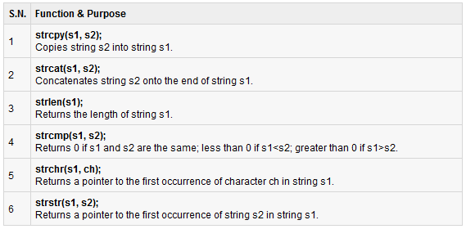
cstring

Slide 27
Comparison between c & c++ String
ACTION | C++ String | C String
Input | << getline | << getline
Output | >> | >>
Copy | = | Strcpy strncpy
Compare | Relational operators to compare | Strcmp strncmp
Concatenation | + += append | Strcat strncat
Extraction | Substr | strstr
Search for substring | Find rfind | strstr
Search for character | Find rfind | Strchr strnchr
Access character | At [ ] | Strchr [ ]
Insert | Insert
Erase | Erase clear
Swap | swap
Convert to other format | C_str | Assign or copy constructor

Slide 28
TASKS:
Find the length of the string (the String should be inserted by the user)
Take 2 strings as an input and concatenate them.
Write a C++ that contain two strings:
String1= “A line is the path of one point moving.”.
String2 = “line is a type of geometric figure”
Perform following functions on these strings:
strfind( ) on String1.// line
Substr()on string 1 // point moving
strlen() on String1 and String2
insert() “ Despicable me!!” in String2
remove() “type” from String2
replace() “moving” from String1 and insert “ Despicable me!!” in String1.
Copy () “line is the path” from String 1 to String2.

Slide 29
Take a loop which will read characters from cin until the user signals the end of data input (<Ctrl>-z in Windows)and count the number of characters read in. It also sends a copy of each character to cout.
Get a character ch from user and returns true if ch is a lowercase alphabetic character or false if it is not.(hint : islower() )
Function Checks
isalpha() is the parameter alphabetic ('A'..'Z' or 'a'..'z')
isdigit() is the parameter a digit (0..9)
isalnum() is the parameter alphabetic or a digit
isspace() is the parameter a space (' ')
ispunct() is the parameter a piece of punctuation
islower() is the parameter a lowercase alphabetic character ('a'..'z')
isupper() is the parameter an uppercase alphabetic character ('A'..'Z')

